Slide 1
MARKETING MANAGEMENT

Slide 2
Evolution of Marketing Concept
The stage of economic self sufficiency:
Small family units carrying out all the work to satisfy their limited and basic needs for food, clothing and shelter. There was no exchange at all.
The barter system:
Some people are able to turn out certain goods quickly. This led to economic specialization. Gradually not only the individuals but the whole tribes and communities turned to specialization. The family or tribe engaged in a particular trade entered into bartering relationship with the others for the goods it does not produce.
Money system:
The economic goods exchanged under barter system created certain difficulties. They were not always of equal values, double coincidence, difficulties in storage and carrying goods from place to place in search of interested parties. The solution came through the development of a common medium of exchange in the form of money. Pricing became the mechanism of exchange process.

Slide 3
The stage of early capitalism:
The early capitalists organized workers into productive units and sought markets to trade their output. There was no serious efforts to study the needs of customers. The concept of marketing under early capitalism was that business activities specially involved in searching for customers or markets moving goods from producer to consumers for the purpose of the sellers gain.
Industrial revolution:
New modes of transportation and methods of communication bought about drastic changes. Mass production became the order of the day. A large variety of low priced goods became available in great abundance. The ever increasing number and size of industries generated the phenomenon of competition. This situation demanded the enterprises to ensure that their products were preferred to those of their competitors. A great variety of new products and services were made available because of development of large and mass scale enterprises.The selling of the products and services became usually difficult. This resulted in emergence of marketing

Slide 4
Marketing
Def: The performance of business activities which directs the flow of goods from the producer to the end user.

Slide 5
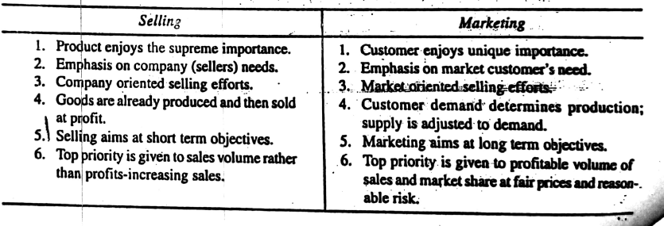
Differences between selling and marketing

Slide 6
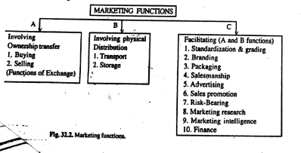

Slide 7
Marketing Functions
There are basically eight functions:
Buying
Selling
Transporting
Storage
Standardization and grading
Financing
Risk bearing
Market information

Slide 8
CHANNELS OF DISTRIBUTION

Slide 9
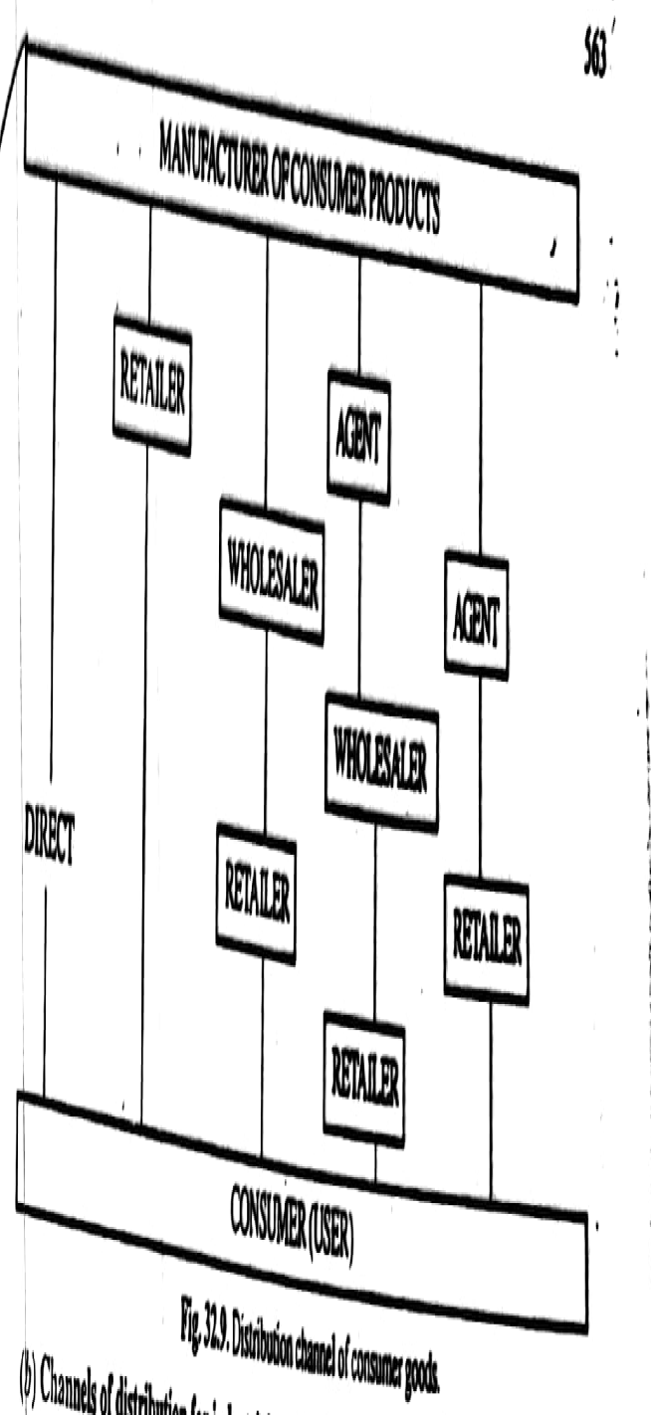
Distribution channels for consumer goods

Slide 10
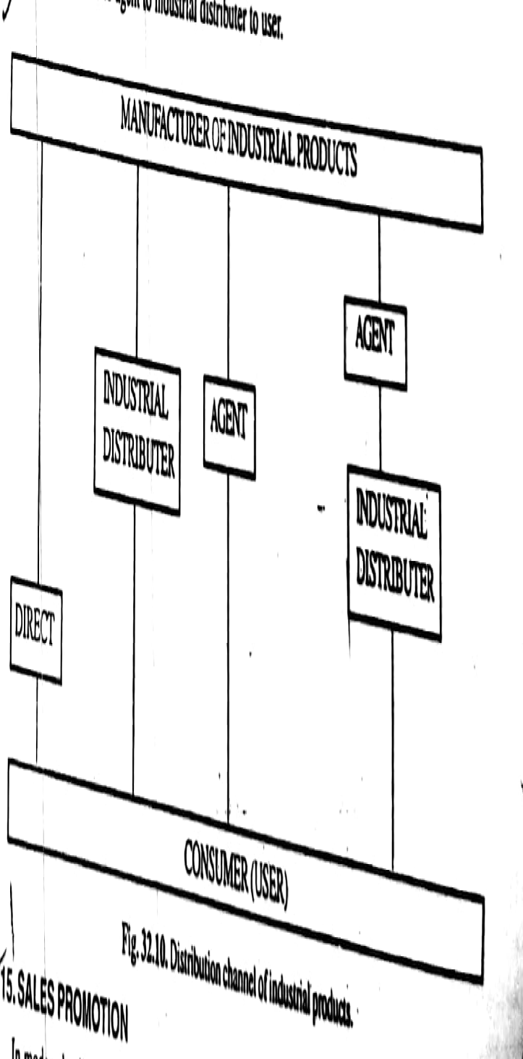
Distribution channels for industrial products

Slide 11
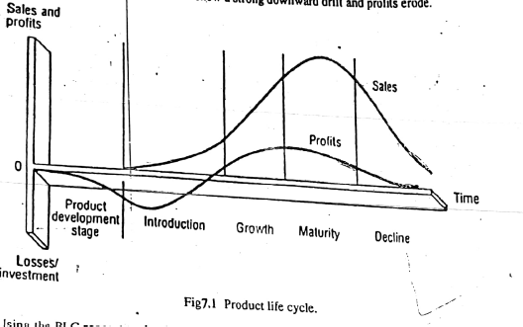
Product life cycle

Slide 12
Stages in product life cycle
There are four stages:
Introduction
Growth
Maturity
Decline/Death

Slide 13
Introduction:
Sales will be low/less – due to customer reluctance and non availability of product
Profits: Nil – Instead losses may also occur due to more investment in advertising and solving bugs (i.e R&D)
Growth:
Sales - starts climbing up – increases- starts accepting the product.
For improving the sales more awareness is created through advertising, reducing the price, making the availability of product in more no of outlets.
Profits: As sales climbs up profits are increases.
Maturity:
Sales and profit will be constant (consistency state) i.e neither increase or decrease – Due to competitors products entering into the market.
At this stage marketing manager will adopt two techniques
Product modification
Market modification

Slide 14
Decline/Death:
Both sales and profit will be declining. No furthur measures can improve sales and profits.
The products lying in this stage are called aged products.

Slide 15
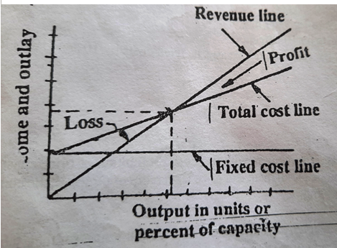
Break even analysis

Slide 16
Break even analysis is a technique for studying the relationships between cost, volume and profit. It is also called Cost-volume-profit analysis.
It enables the financial manager to understand the impact of changes in the volume of output on cost and profit.
It is also an instrument of profit planning as it helps in finding the level of output which should be produced in order to generate the planned level of profit.
Given the fixed cost, variable costs and price per unit, break even analysis is used to find the level of output at which total (Fixed and variable) cost of production is equal to the total revenues generated by the sale of that output.
The point at which total cost is equal to total revenue is called break even point.
In break even analysis a clear distinction is made between fixed costs and variable costs.

Slide 17
Assumptions
Variable costs change directly and proportionately with output.
Fixed cost remain unchanged irrespective of the level of output.
Sales price is fixed and the firm can sell any quantity of its production at this price.

Slide 18
Contd.
Fixed costs are those costs which must be born irrespective of the level of output. These costs are the costs of depreciation, insurance, rent, administration etc.
Variable costs are those costs which vary directly with output. These are per unit costs relating to materials, supplies , wages etc.
In break even analysis, variable costs are assumed to vary in a linear relationship with the output. This is the reason for the straight line shape of the variable cost curve.

Slide 19
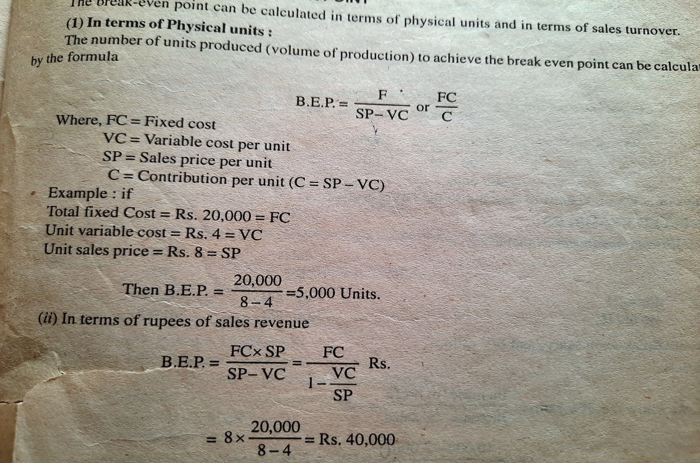
Break even problems

Slide 20
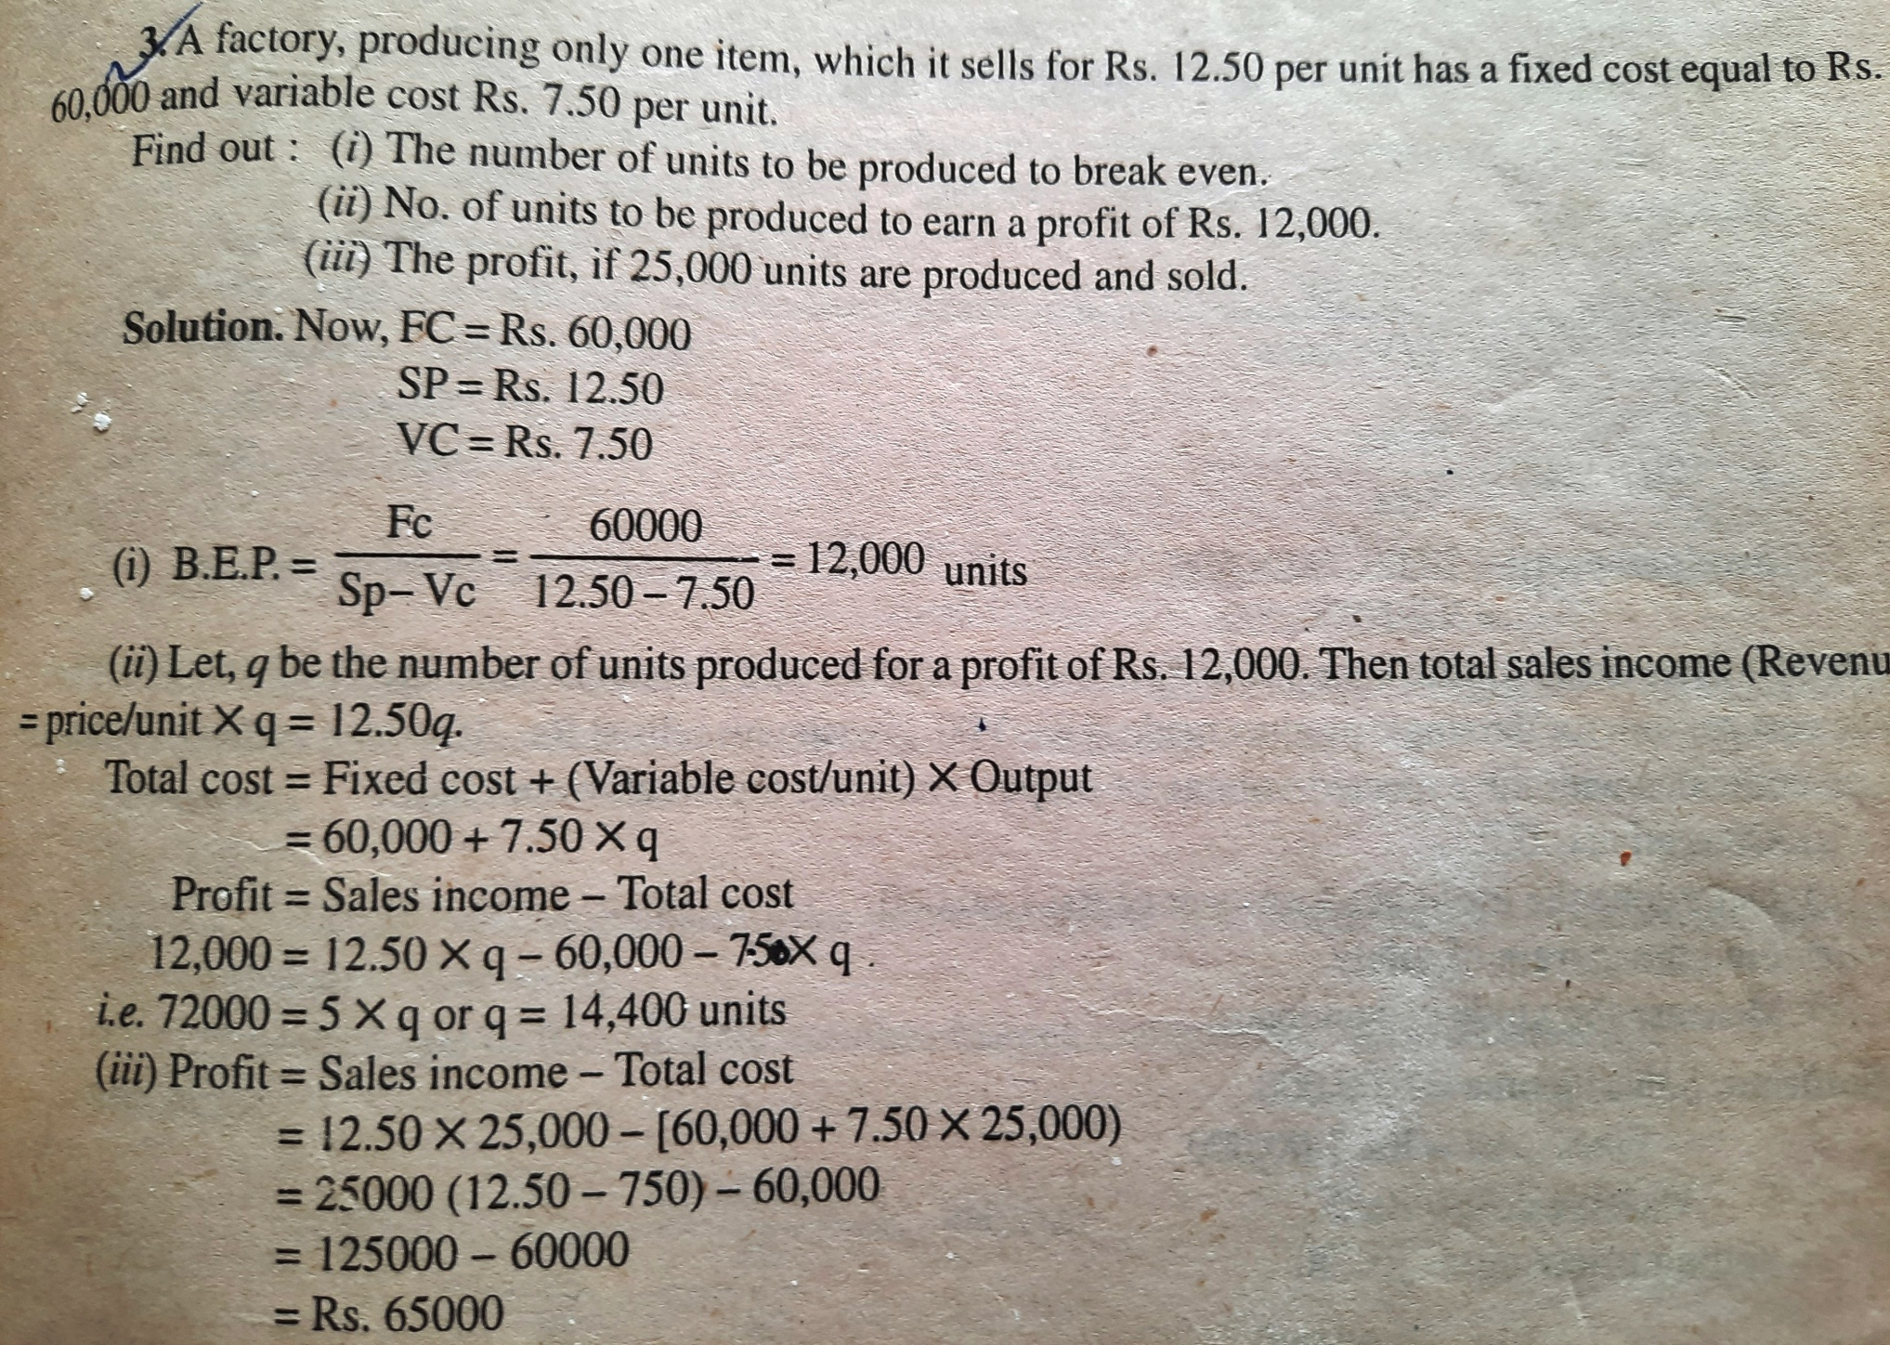
Example:2

Slide 21
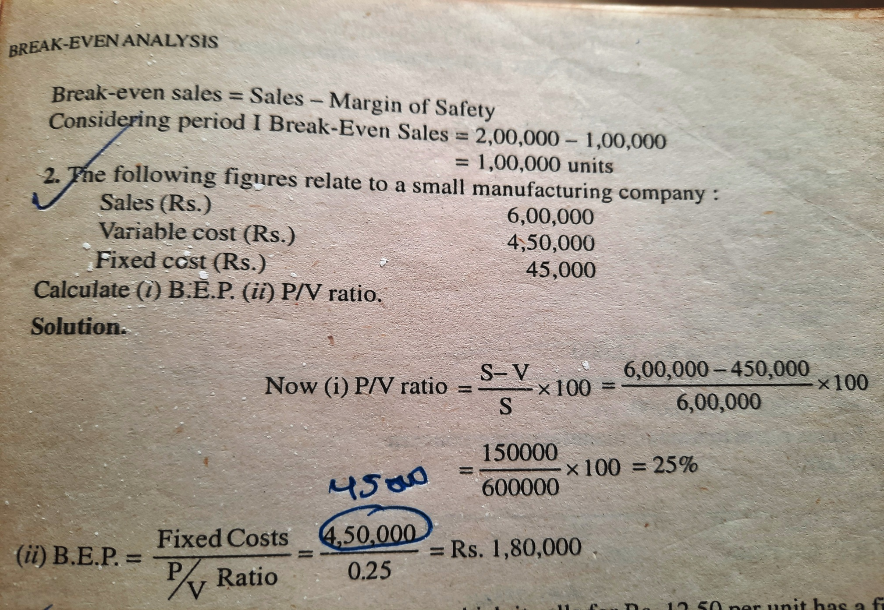
Example:3

Slide 22
Example:4
Using the data below calculate BEP in terms of sales value and in units.
Fixed factory overhead cost Rs.60,000/-
Fixed selling overhead cost Rs.12,000/-
Variable manufacturing cost Rs.12/-
Variable selling cost per unit Rs.3/-
Selling price per unit Rs.24/-

Slide 23
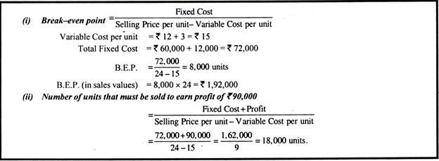

Slide 24
Market Research
Def: Application of scientific methods to the solution of market problems

Slide 25
Classification of market research
Research on prices
Research on products
Research on consumers
Research on Advertising
Research on Distribution channels etc…

Slide 26
Steps involved in Market Research
Identifying the problem and defining the objectives clearly
Collecting relevant data related to the problem
Analyzing the data using statistical tools
Preparation of research report
Follow up action

Slide 27
Benefits of Market research
Planned production
New products
Reduction in risk
Identify potential markets or customers
Customer satisfaction and profit
Minimization of cost etc..

